Slide 1
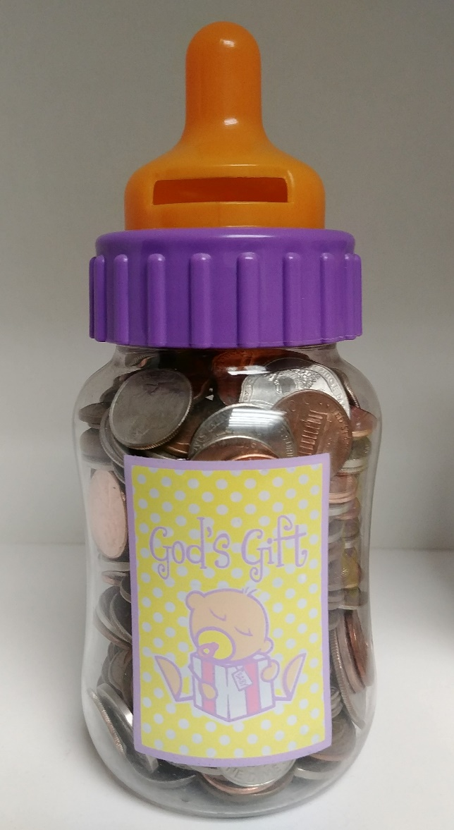
Participate in God’s life-giving work!
It’s Baby Bottle Time!
Take a bottle
Fill it with $$
Bring it back
Thank you!

